Slide 1
Reduction of Multiple Subsystems

Slide 2
In this chapter you will learn the following:
How to reduce a block diagram of multiple subsystems to a single block representing the transfer function from input to output
How to analyze and design transient response for a system consisting of multiple subsystems
How to represent in state space a system consisting of multiple subsystems

Slide 3
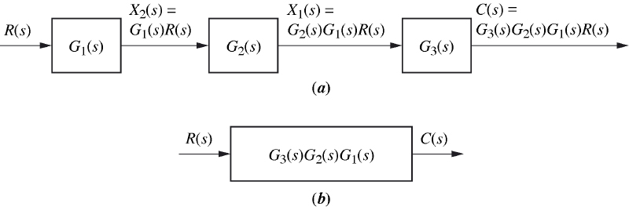
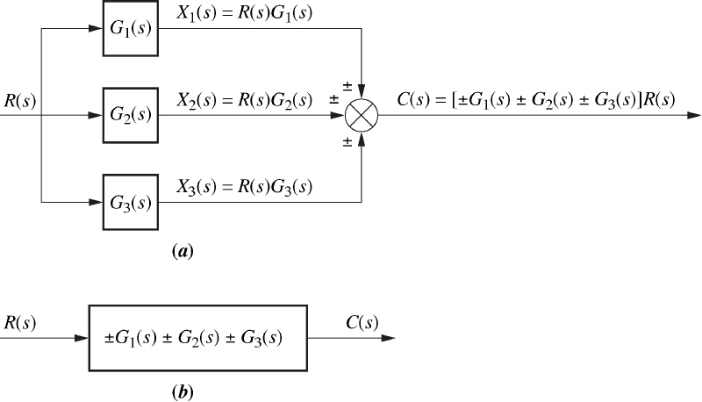
Cascade form
Parallel form

Slide 4
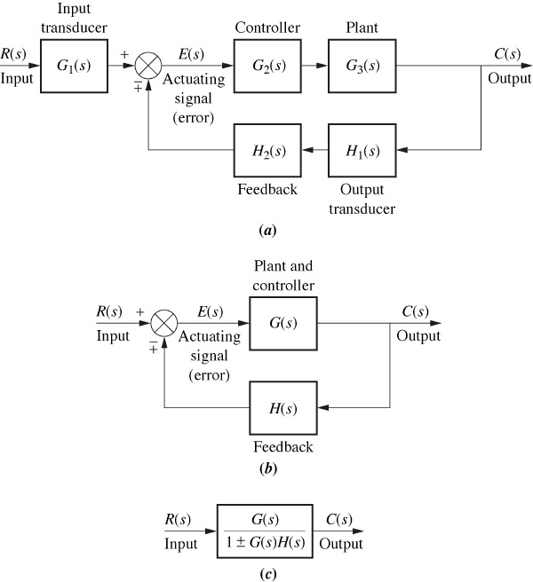
Feedback form

Slide 5
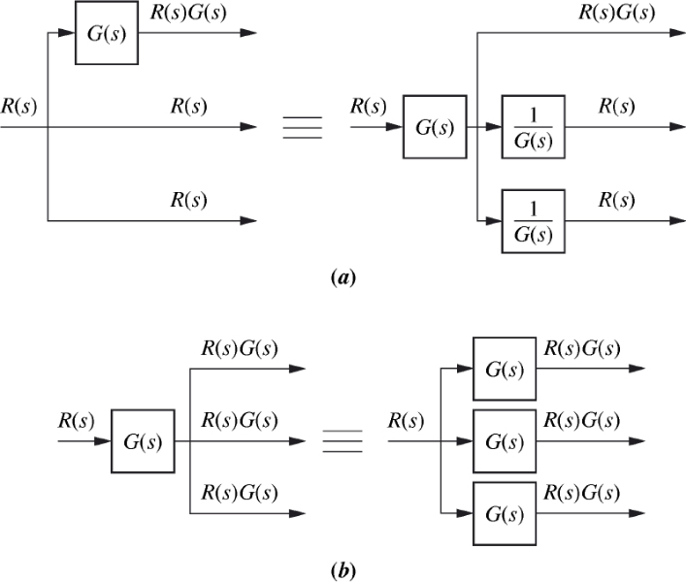
Equivalent forms

Slide 6
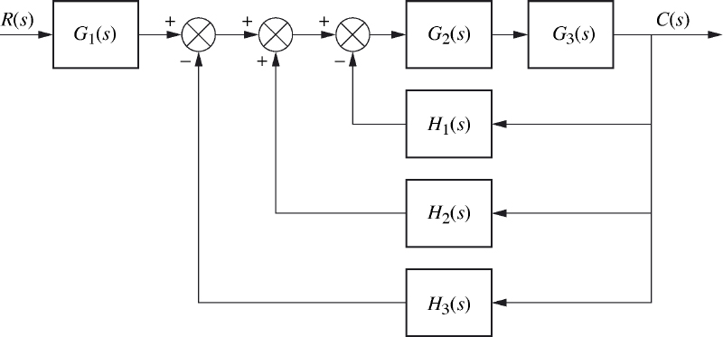
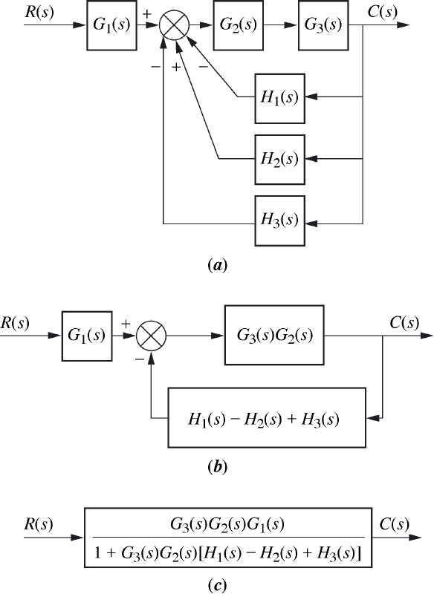
Example 5.1 of the text

Slide 7
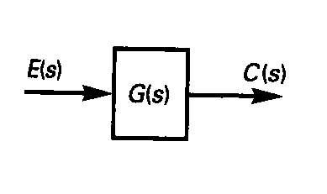
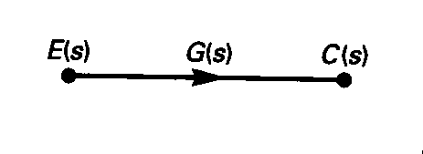
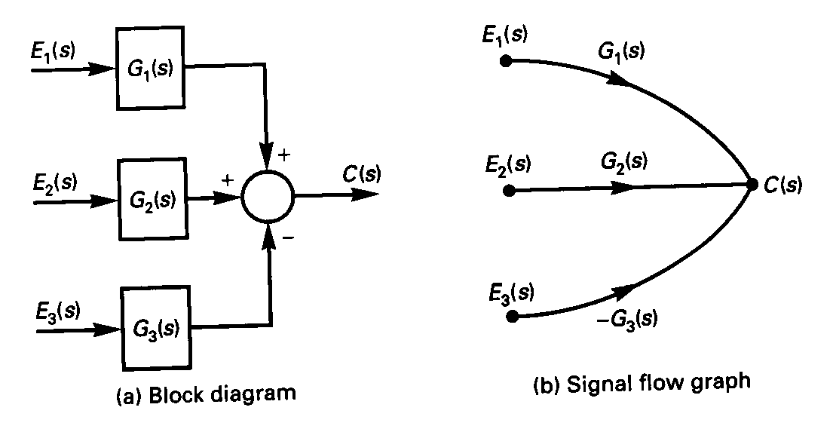
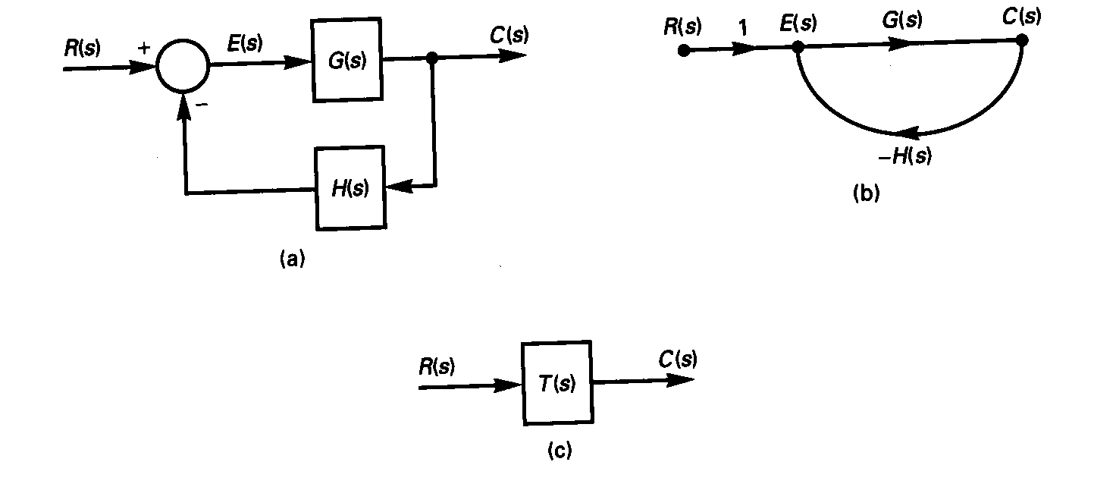
Signal Flow Graphs
Signal-flow graphs are an alternative to block diagrams.

Slide 8
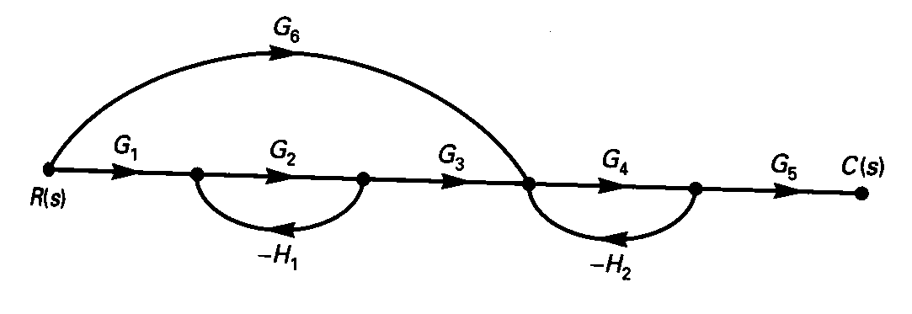
Mason’s Formula
Motivation:
How to obtain the equivalent Transfer Function?
Ans: Mason’s formula

Slide 9
Mason’s Gain Formula
This gives a procedure that allows us to find the transfer function, by inspection of either a block diagram or a signal flow graph.
Source Node: signals flow away from the node.
Sink node: signals flow only toward the node.
Path: continuous connection of branches from one node to another.
Forward path: is a path that connects a source to a sink in which no node is encountered more than once with all arrows in the same direction.

Slide 10
Loop: a closed path in which no node is encountered more than once. Source node cannot be part of a loop.
Path gain: product of the transfer functions of all branches that form the path.
Loop gain: products of the transfer functions of all branches that form the loop.
Nontouching: two loops are non-touching if these loops have no nodes in common.

Slide 11

An Example
Loop 1 (-G₂H₁) and loop 2 (-G₄H₂) are not touching.
Two forward paths:

Slide 12


Slide 13


Slide 14
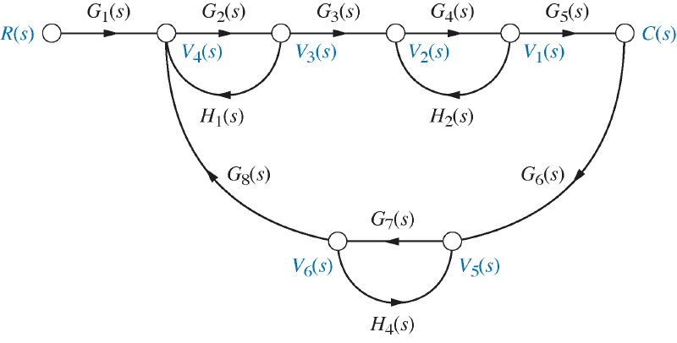
Do example 5.7 of the Text

Slide 15
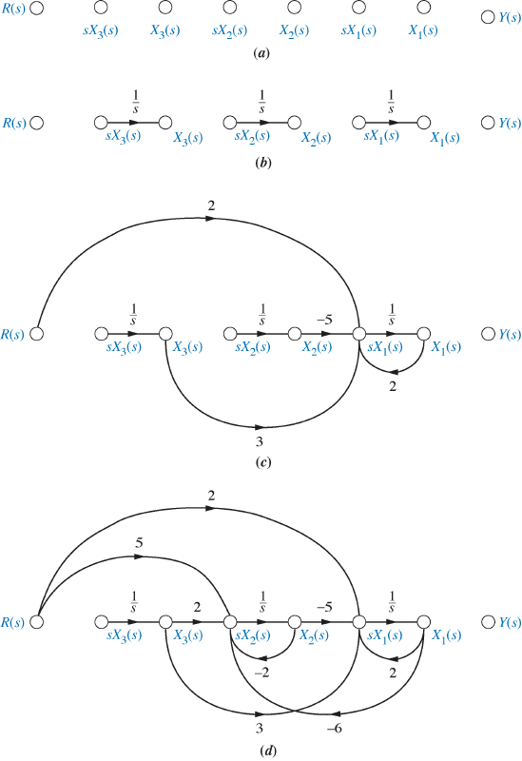
Signal Flow Graphs and State Equations

Slide 16
